Slide 1
Desperately Seeking Default!
Geoff Huston
APNIC

Slide 2
In the Telephone Network
Anyone could dial anyone else
All telephones were equally reachable

Slide 3
In the Telephone Network
Internet
Anyone can reach anyone else?
All connected endpoints are equally reachable?

Slide 4
In the Telephone Network
Internet
Anyone can reach anyone else?
All connected endpoints are equally reachable?
NATs changed all that – so our current expectations are that if you stand up a public service on port 80 (or 443 for that matter) then everyone can reach you

Slide 5
In the Telephone Network
Internet
Anyone can reach anyone else
All connected endpoints are equally reachable
We might THINK this, but is it true ALL the time?
NATs changed all that – so our current expectations are that if you stand up a public service on port 80 (or 443 for that matter) then everyone can reach you

Slide 6
What do we see?
Is everyone really connected to everyone else?

Slide 7
Connection Failure
Outbound SYN
client
server
Busted SYN ACK
Return path
What the server sees is an incoming SYN, but no matching incoming ACK

Slide 8
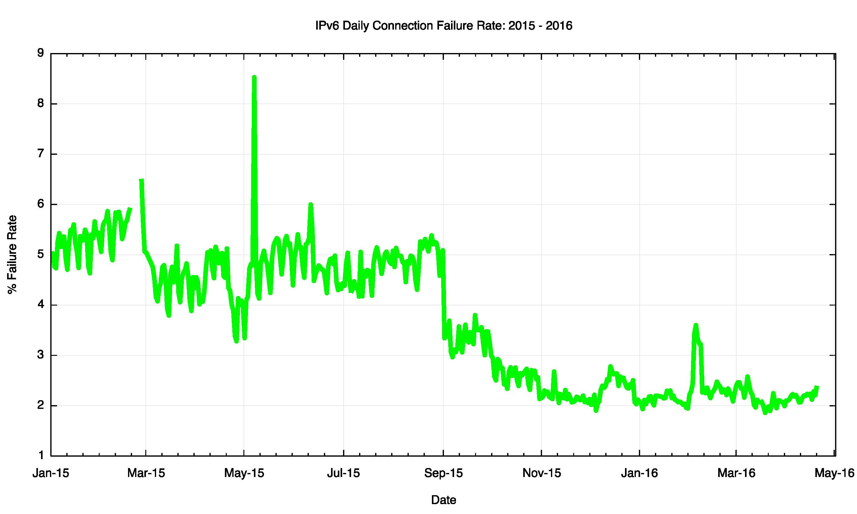
Daily IPv6 Failures
RIP
Flash!
HTML5 + TLS +
Mobile Devices

Slide 9
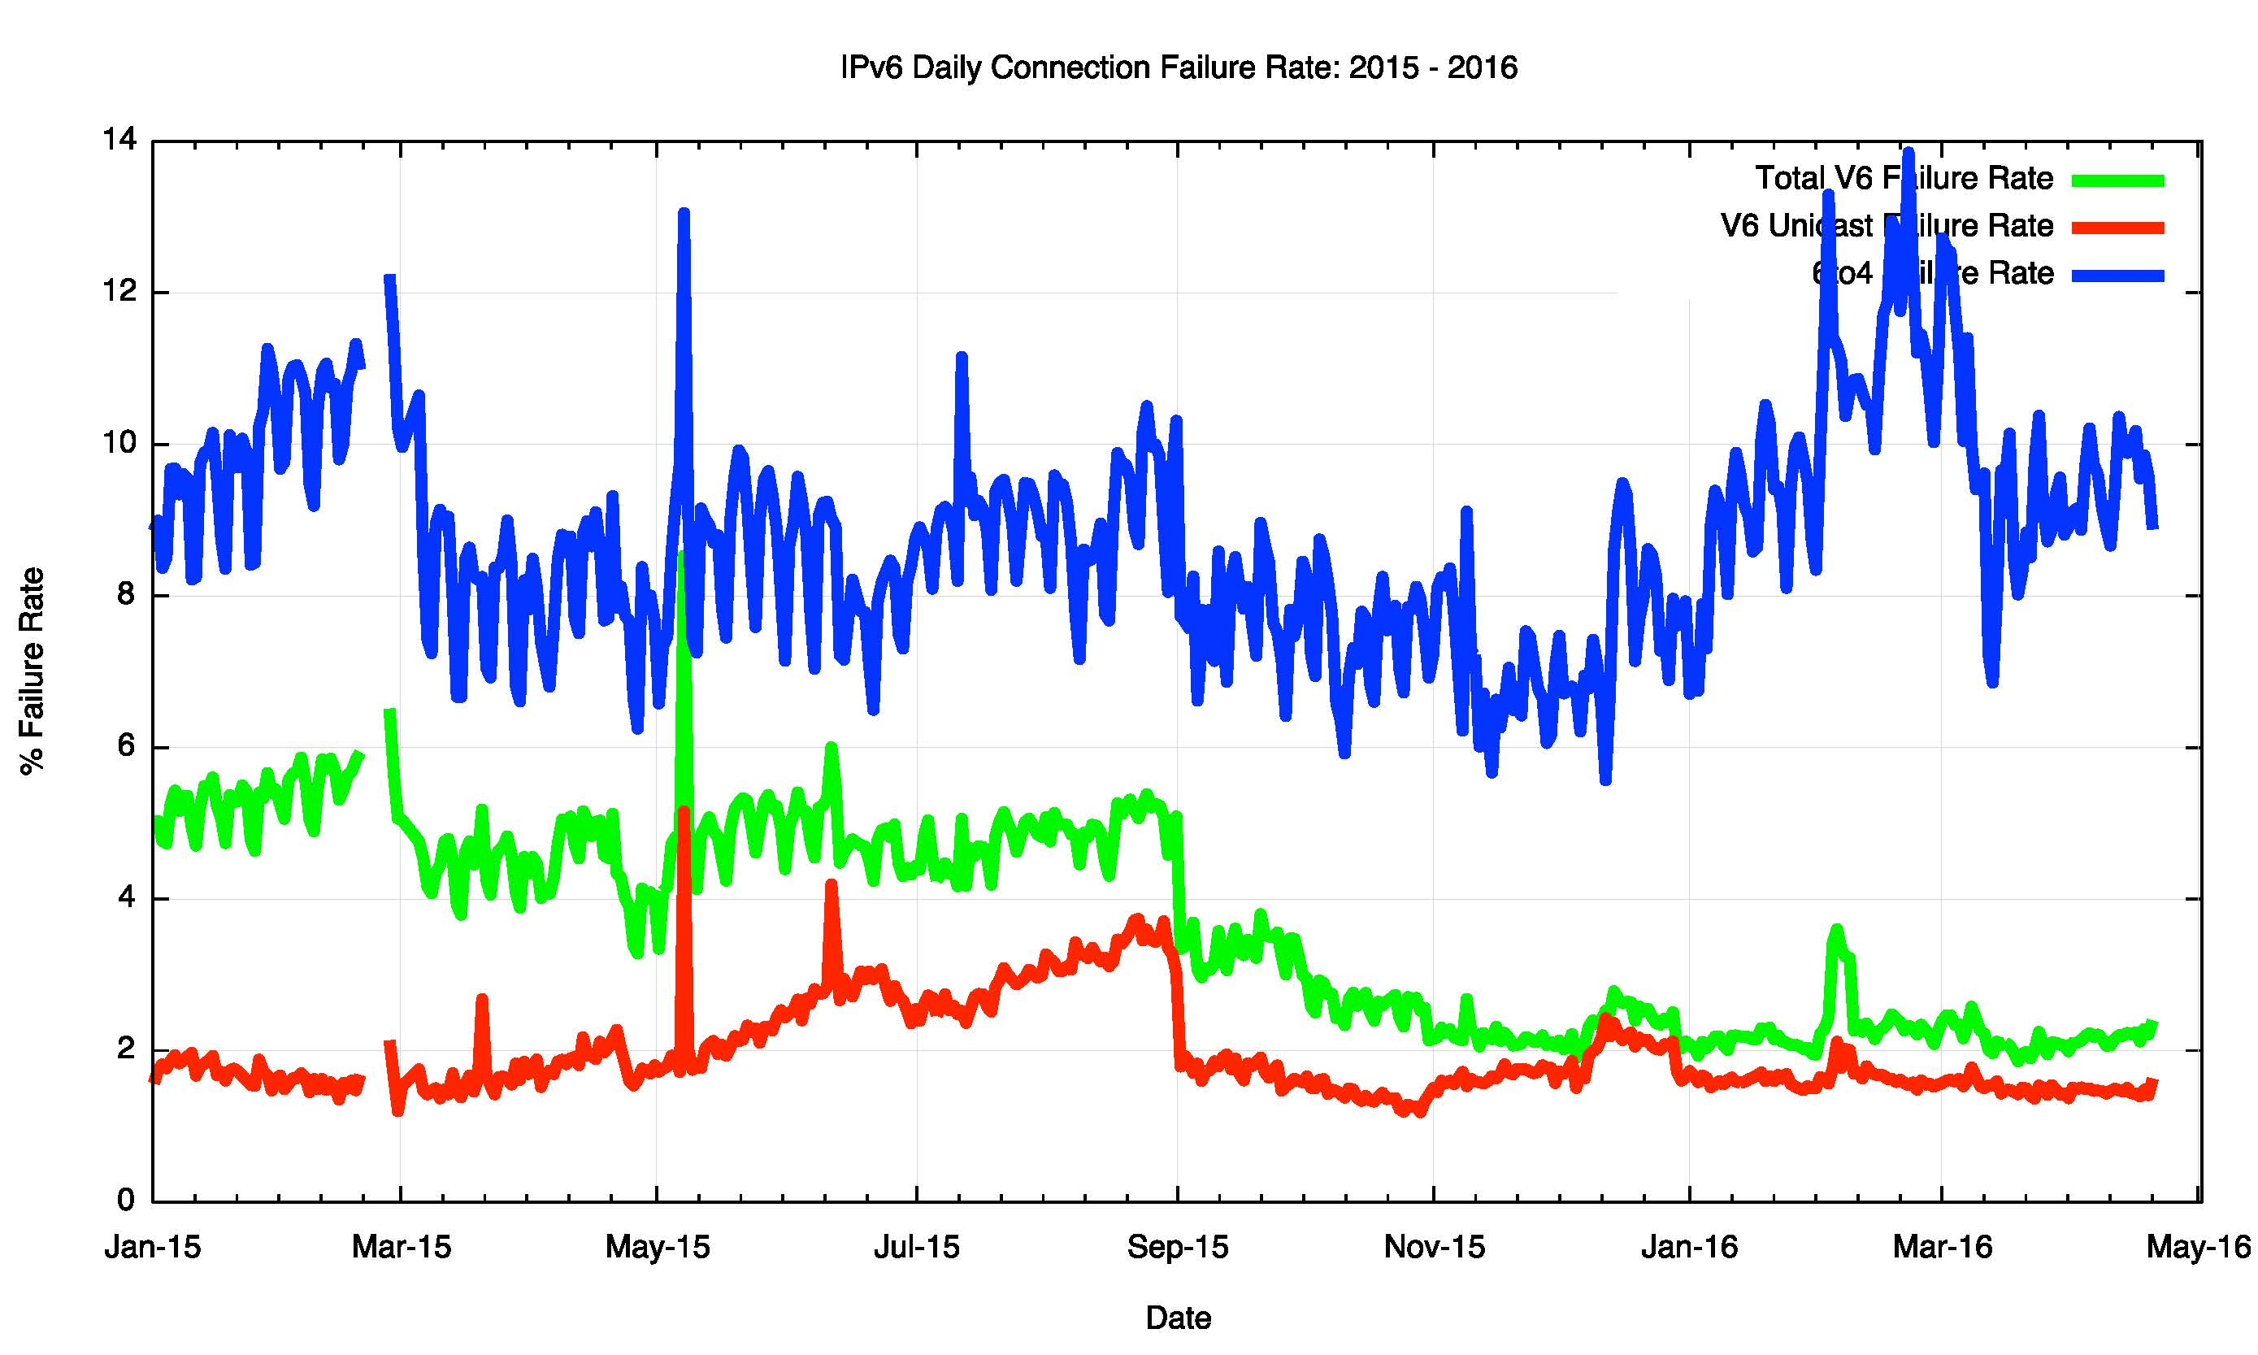
Daily IPv6 Failures

Slide 10
IPv6 Failures
1.8% failure for non-6to4 V6 is unacceptable!
Why is this happening
  Auto-tunnelling?
  Lousy CPE firmware?
  Strange firewall filters?
But is all of this due to local configuration / equipment? What is the comparable view in IPv4?

Slide 11
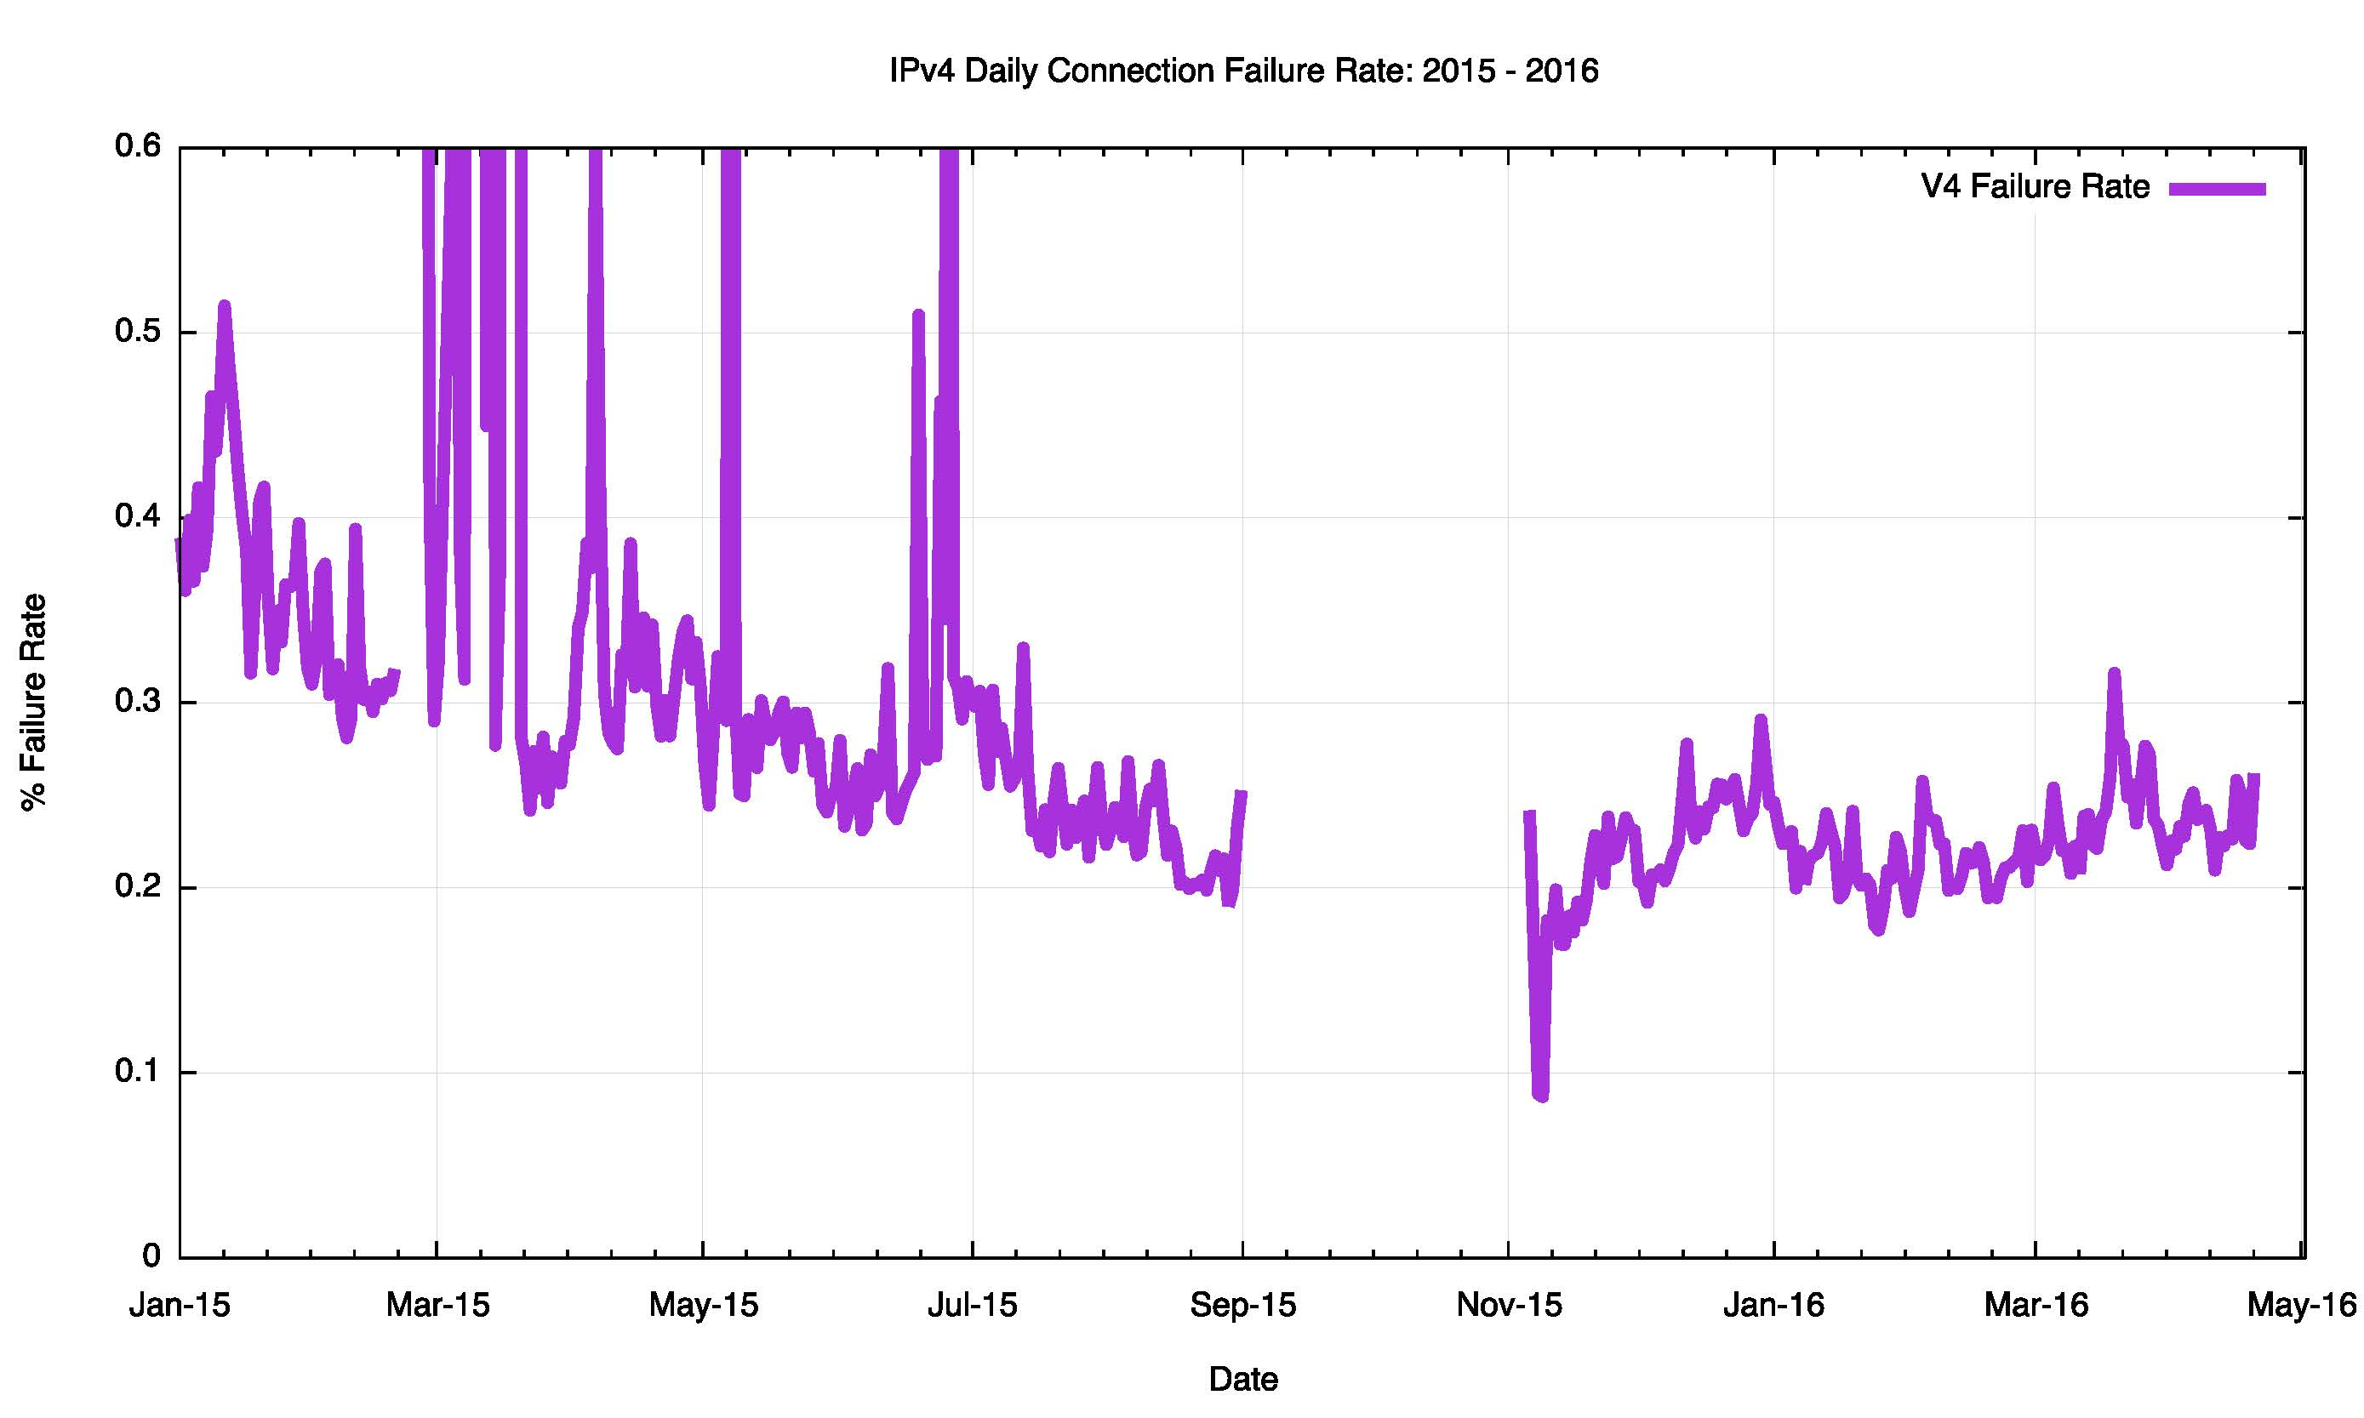
IPv4 Connection Failure
Missing PCAP data

Slide 12
IPv4 Failures
IPv4 failures are around 1 in 500
And we are pretty sure its NOT:
  Auto-tunnelling
  Lousy CPE firmware
  Strange firewall filters
So what is the reason for this residual asymmetric failure rate?
Is it asymmetric routing connectivity?

Slide 13
Route Views Routing Table

Slide 14
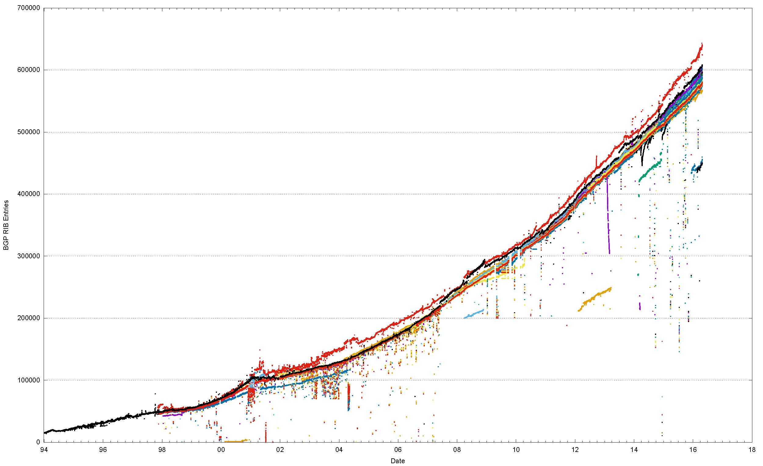
20 Years of Routing the Internet
This is a view pulled together from each of the routing peers of Route Views

Slide 15
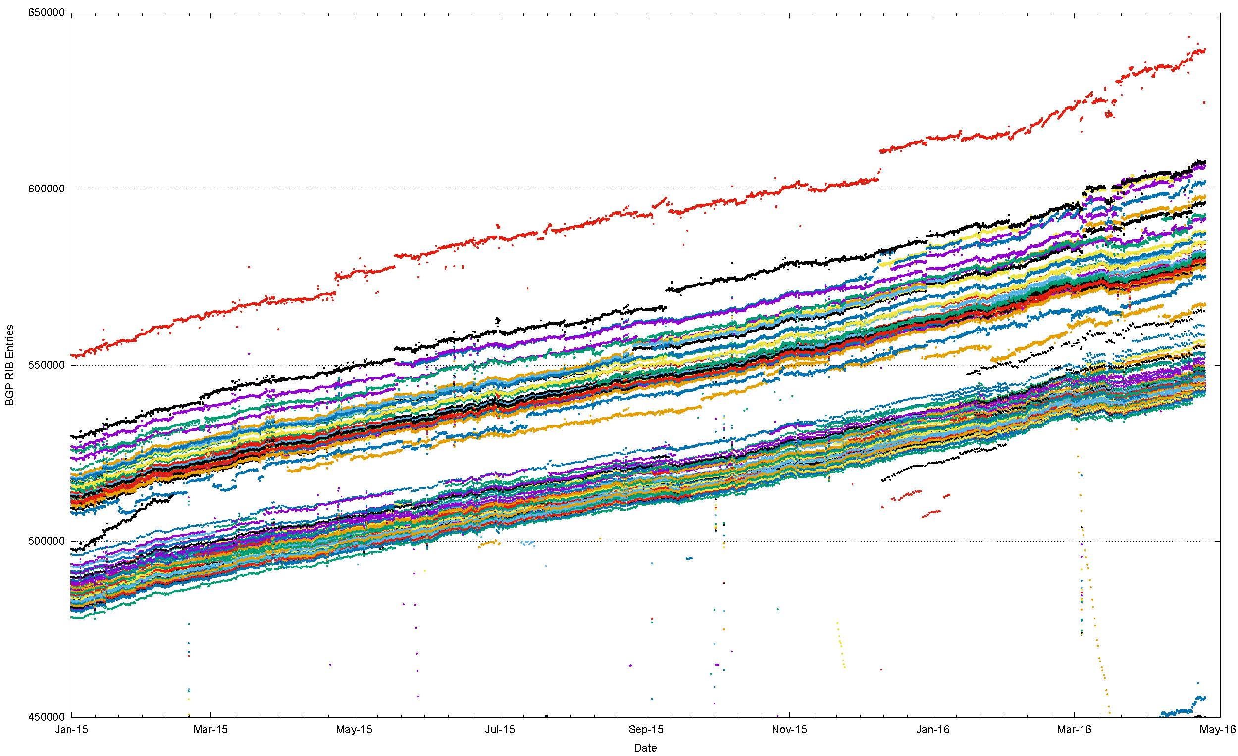
2015/16, Route Views + RIS
This is a view pulled together from each of the routing peers of Route Views and RIS

Slide 16
Different peers see a slightly different Internet
But is this just traffic engineering more specifics?
Or do different peers see a different set of reachable addresses in the routing table?

Slide 17
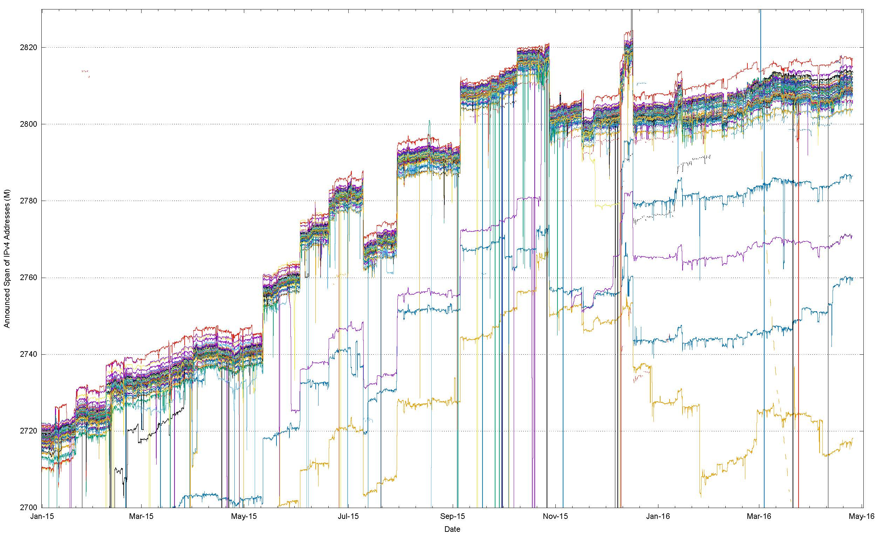
Address Span
(Route Views + RIS data sets)

Slide 18
Address Span
(Route Views + RIS data sets)
15 M Addresses

Slide 19
What does this mean?
Each peer of RouteViews and RIS announces a span of addresses that appears to be a unique span.
In total, these spans agree to within 15M addresses, but this means that there are at least 15M uniquely addressed endpoints that cannot be reached from all other endpoints.
This variation is stable, so its not transient routing that is generating this – the reasons for this difference are structural

Slide 20
What about IPv6?

Slide 21
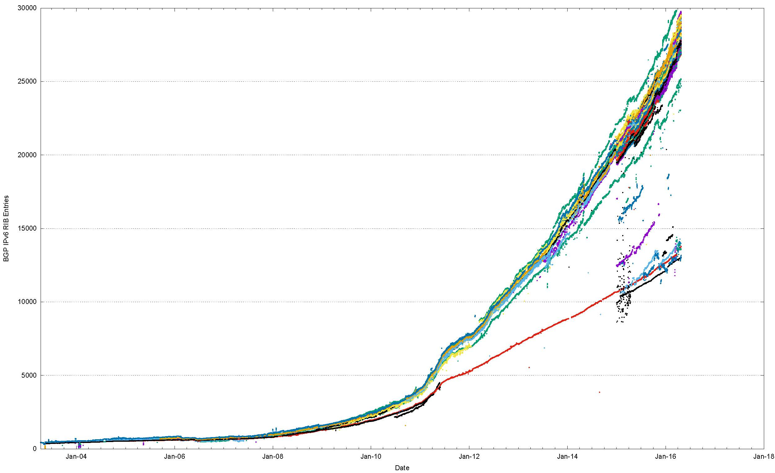
The Route Views view of IPv6
World IPv6 Day
IANA IPv4 Exhaustion

Slide 22
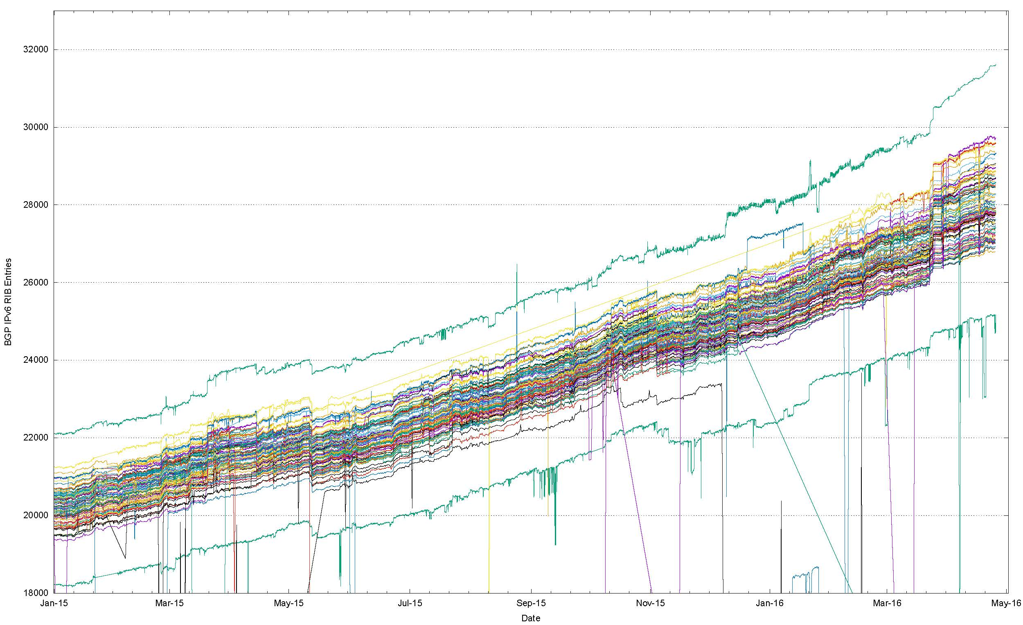
Number of IPv6 Routes in 2015/16

Slide 23
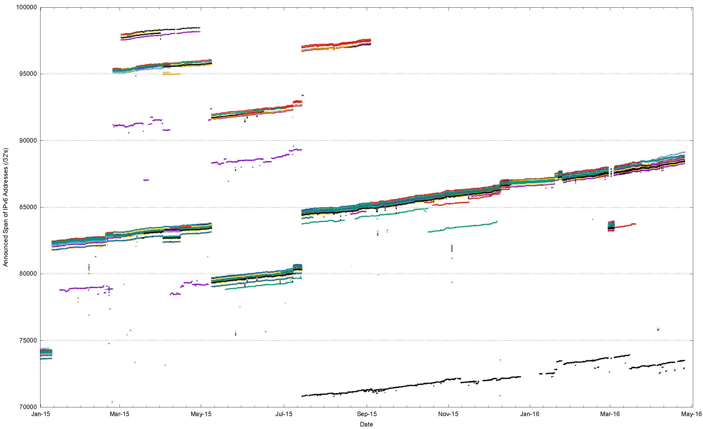
IPv6 Announced Address Span Variation (RV + RIS)

Slide 24
What is “default”?
There is no definition of the route set that is “default”
At best it’s an informal quorum
  So lets define this quorum by arbitrarily setting the quorum threshold at 2/3
  i.e. if 2/3 of the peers of a route collector advertise a route then it is part of the default quorum.
Individual peer networks will contain route sets that differ from this quorum by having both additional prefixes and holes.
  Lets look at the variance from the quorum

Slide 25
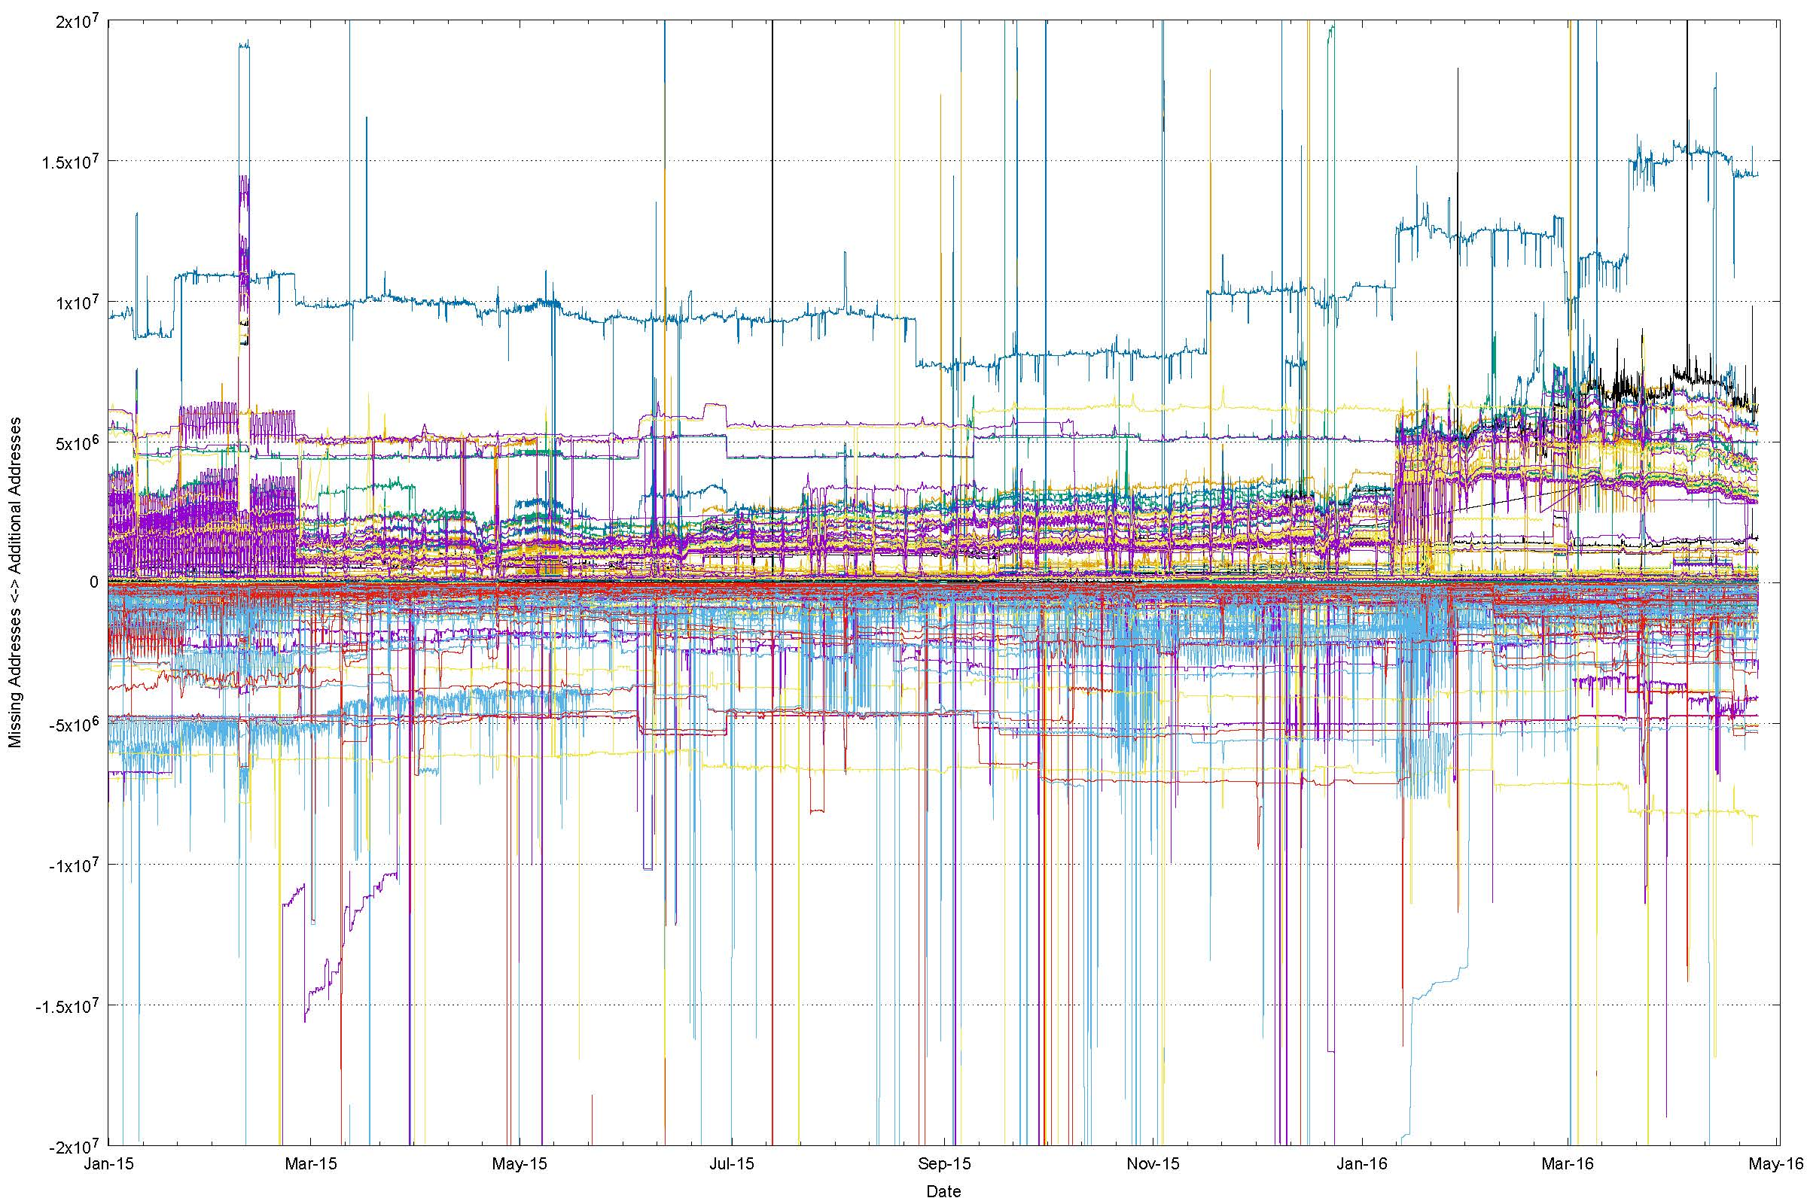
A “Quorum” deviation view of IPv4

Slide 26
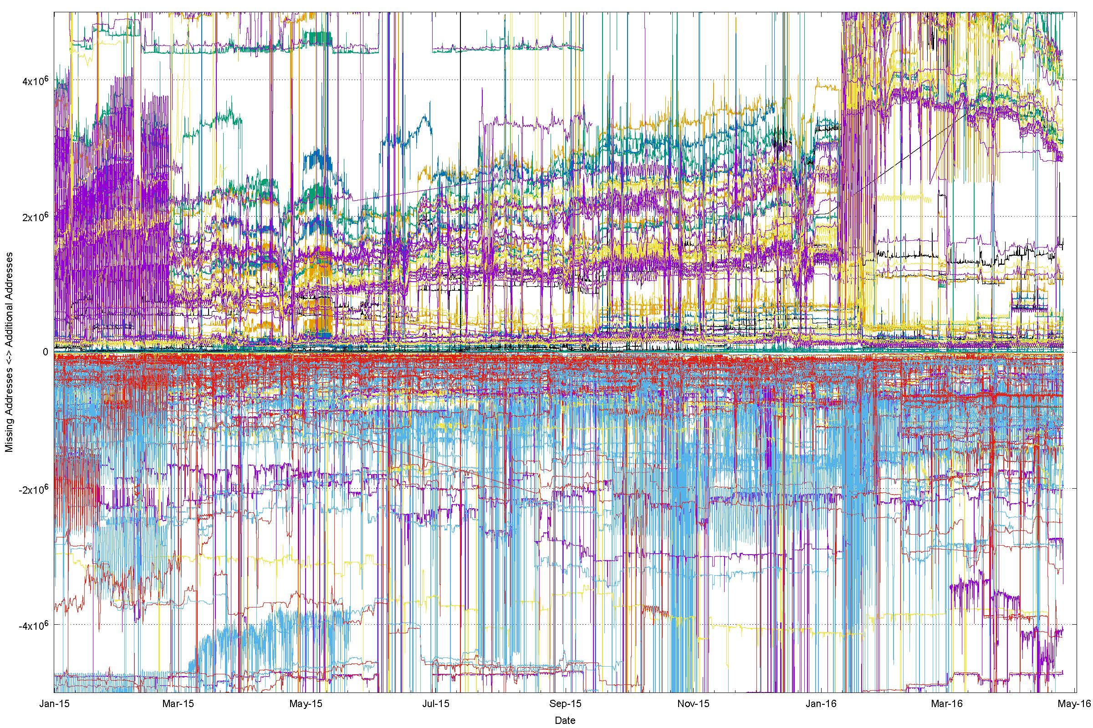
A magnified view

Slide 27
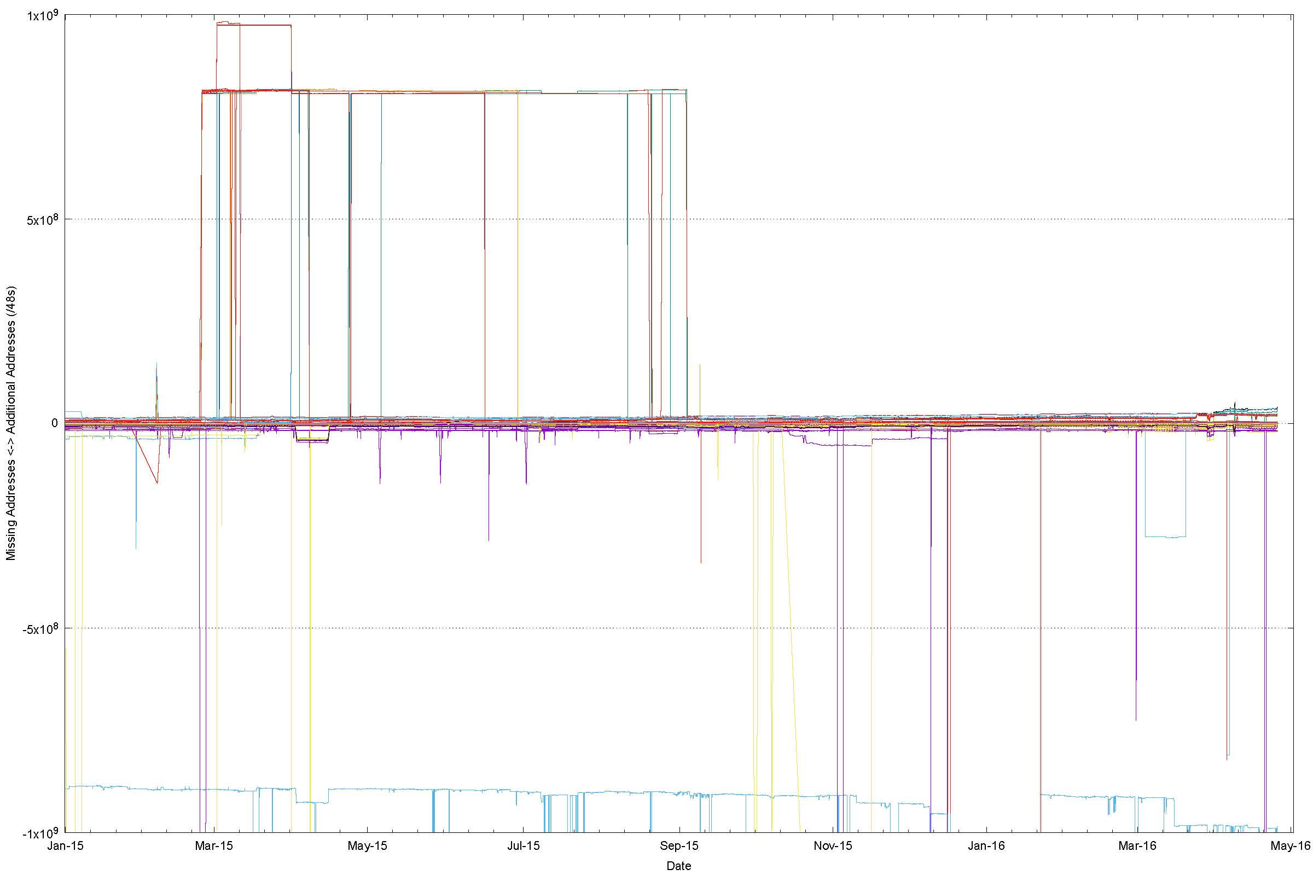
IPv6 “Quorum” Deviation

Slide 28
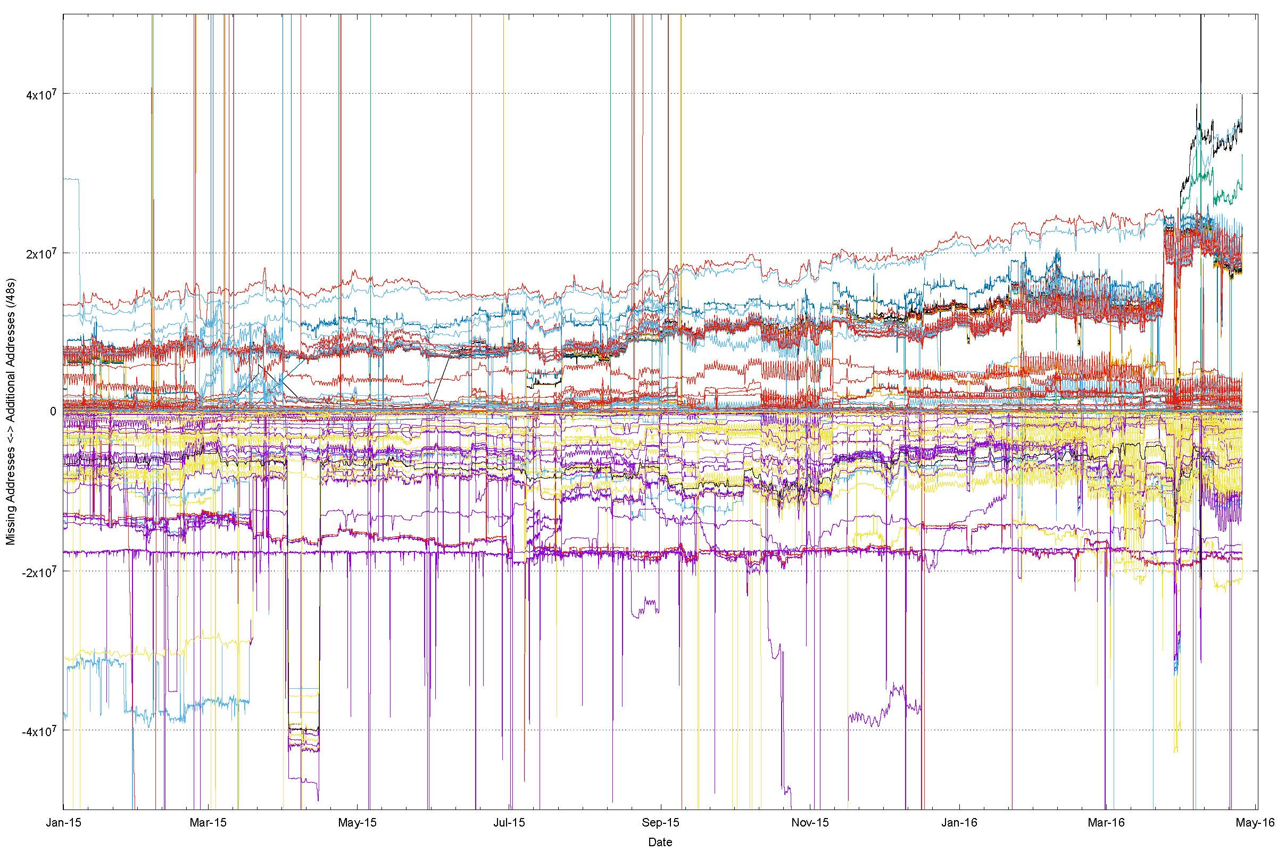
Zooming In

Slide 29
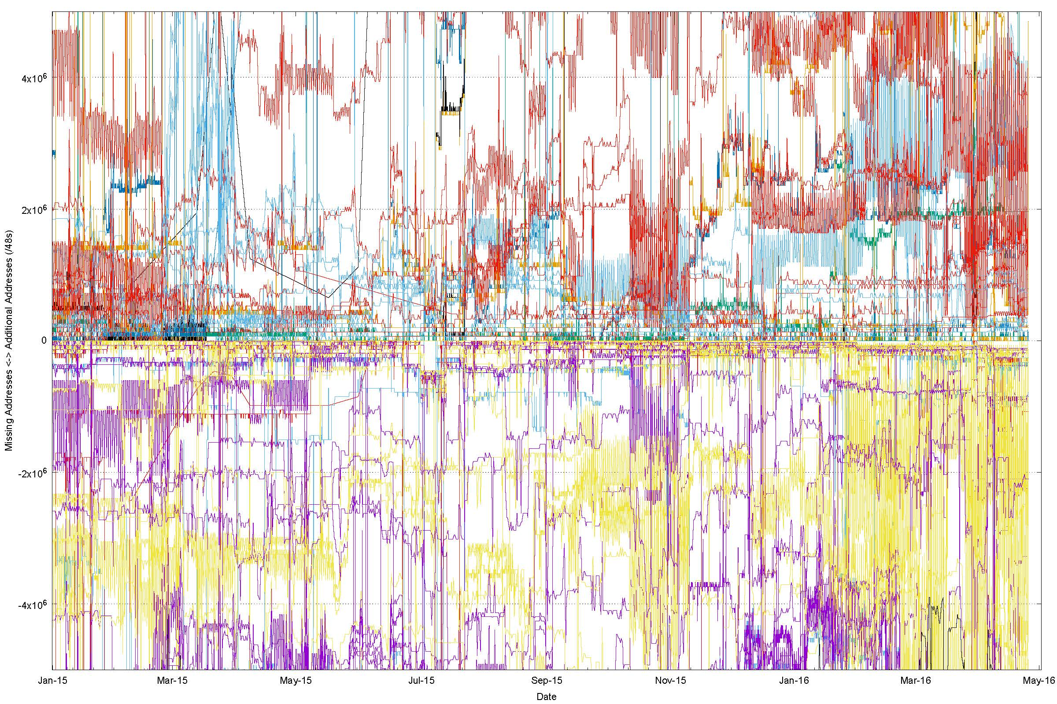
And Again

Slide 30
And Again!

Slide 31
Quorum Deviation for RVA IPv4 Peers (25th April 2016)

Slide 32
Quorum Deviation for RIS IPv4 Peers (25th April 2016)

Slide 33
Quorum Deviation: IPv6, RVA

Slide 34
Quorum Deviation: IPv6, RIS

Slide 35
It’s structural, not temporal
There is a visibile stability to deviation from the quorum route set
  The variation from the quorum is long – term stable, and does not rapidly self-correct
We appear to assume that all Tier 1 providers, and their Tier 2, 3, … resellers offer the same reachability set as each other – i.e. ”default” is consistent everywhere
But this is not necessarily the case all the time for every address in the routing system
“Default” appears to vary by provider and by location
  E.g.: 25 April, 1600 UTC:
    AS2914: RouteViews 2,808,560,896 addresses
    RIS: 2,807,358,208

Slide 36
So What?
Surely all this is patched up by the widespread use of default in addition to specific routes? (*)
* Internet Optometry: Assessing the Broken Glasses in Internet Reachability”,
R. Bush, O. Maennel, M. Roughan, S Uhlig, ACM SIGCOMM IMC, 2009

Slide 37
So What?
Surely all this is patched up by the widespread use of default in addition to specific routes?
  Well, not really
  Default points along upstream transits
  It does not patch downstreams
Route to B not propagated on this connection
Packet from B to A follows explicit route
A
Packet from B to A follows default and then
dropped
B

Slide 38
To Recap: What is causing this?

Slide 39
To Recap: What is causing this?
Could part of this be due to connectivity failure?

Slide 40
Connection Failure
Outbound SYN
client
server

Slide 41
Connection Failure
Outbound SYN
client
server
SYN ACK
Return path

Slide 42
Connection Failure
Outbound SYN
client
router
server
Busted SYN ACK
Return path

Slide 43
Connection Failure
Outbound SYN
client
router
server
Busted SYN ACK
Return path
ICMP Dest Unreachable

Slide 44
Connection Failure
Outbound SYN
client
router
server
Busted SYN ACK
Return path
ICMP Dest Unreachable
What the server sees is an incoming SYN, and then an ICMP destination unreachable

Slide 45
Connection Failure
Outbound SYN
client
router
server
Busted SYN ACK
Return path
ICMP Dest Unreachable
What the server sees is an incoming SYN, and then an ICMP destination unreachable
But this is not a reliable signal – routers do not always generate an ICMP Dest Unreachable, and firewalls often filter them. But they are still visible some of the time.

Slide 46
And we see this … here’s an example
14:16:05.999497 IP (tos 0x0, ttl 55, id 31005, offset 0, flags [none], proto ICMP (1), length 80)
84.41.108.74 > 139.162.146.97: ICMP host 46.163.63.47 unreachable, length 60
Outer packet is an ICMP Packet with a “destination unreachable” code sent to the server from the router at address 84.41.108.74
IP (tos 0x0, ttl 57, id 0, offset 0, flags [DF], proto TCP (6), length 52)
139.162.146.97.443 > 46.163.63.xx.52087: Flags [S.], cksum 0x5130 (correct), seq 3917125220, ack 685287936, win 29200, options [mss 1460,nop,nop,sackOK,nop,wscale 7], length 0
Payload packet is a SYN+ACK packet

Slide 47
Of course it’s not the only reason why connections fail in IPv4
NATs are also erratic:
14:16:37.959604 IP (tos 0x38, ttl 55, id 40091, offset 0, flags [none], proto ICMP (1), length 80)
197.114.50.xx > 139.162.146.97: ICMP host 197.114.50.20 unreachable, length 60
IP (tos 0x20, ttl 49, id 0, offset 0, flags [DF], proto TCP (6), length 52)
139.162.146.97.443 > 197.114.50.xx.55648: Flags [S.], cksum 0xeb1e (correct), seq 3454637726, ack 3599361621, win 29200, options [mss 1400,nop,nop,sackOK,nop,wscale 7], length 0
Why is the destination telling us that it is unreachable?

Slide 48
Of course it’s not the only reason why connections fail in IPv4
NATs are also erratic:
14:16:37.959604 IP (tos 0x38, ttl 55, id 40091, offset 0, flags [none], proto ICMP (1), length 80)
197.114.50.xx > 139.162.146.97: ICMP host 197.114.50.20 unreachable, length 60
IP (tos 0x20, ttl 49, id 0, offset 0, flags [DF], proto TCP (6), length 52)
139.162.146.97.443 > 197.114.50.xx.55648: Flags [S.], cksum 0xeb1e (correct), seq 3454637726, ack 3599361621, win 29200, options [mss 1400,nop,nop,sackOK,nop,wscale 7], length 0
Why is the destination telling us that it is unreachable?
It’s probably a CGN that has lost its binding state while the TCP session was being established!

Slide 49
Connectivity appears to have a 1 in 500 failure rate in IPv4
Some of it is based on asymmetric views of connectivity from the routing system
Some of it is based on anomalous NAT behaviours
And some of it … we just can’t tell!

Slide 50
In the Telephone Network
Internet
Almost
Almost
most of the time
Anyone can reach anyone else
All connected endpoints are equally reachable

Slide 51
Thanks!

